Slide 1


Slide 2


Microsoft Graph API Deep Dive
Donald Hessing
Microsoft Digital Lead Architect,
Capgemini, The Netherlands
Microsoft Certified Master SharePoint (MCM)
Notes:
To add your image, first delete the place holder image as shown in the white box. Then insert your picture and scale it to be bigger than the size of the white box shown. Finally, right click on your image and select ‘Send to back’ – your image should now be framed correctly.

Slide 3
Agenda
Introduction
Authentication
Microsoft Graph with ASP.NET / MVC 5 and Groups
Webhooks
App only calls
Microsoft Graph Sites
Microsoft Graph Limitations and non Microsoft Graph resources

Slide 4

“
The most strategic developer surface area for us is Office 365
"Data is the new Money"
—James Whittaker
”
—Satya Nadella
Notes:
Toen vorig jaar de office 365 APIs gelaunched waren tijdens Build en een week later tijdens de SharePoint Conference in Las Vegas Satya Nadella zei dat Officd 365 het meest strategische deloperplatform.

Slide 5

Office 365 by the numbers
4
Trillion Emails sent with Office 365
50
Million objects in the directory
60
Billion attachments
470
Petabytes of data
8
Billion relationships in Office graph
850
Million meetings per month
70%
Fortune500 companies
purchased Office 365
in the last 12 months

Slide 6
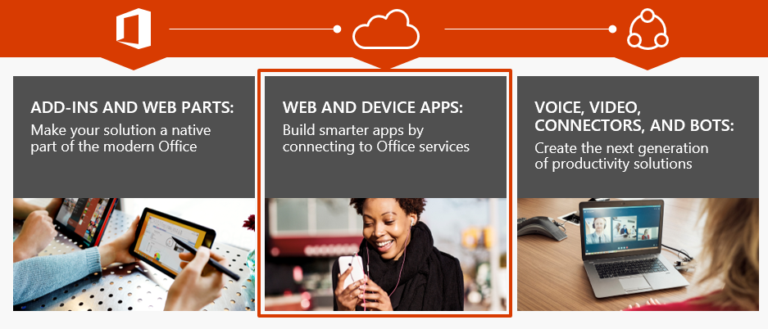
Office platform What can I build?

Slide 7
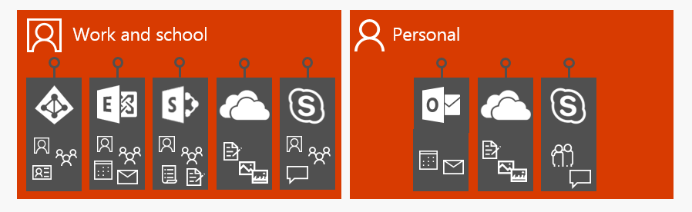
Before Microsoft Graph
Many different APIs to access data
Separate Authentication stack for Work and Personal

Slide 8
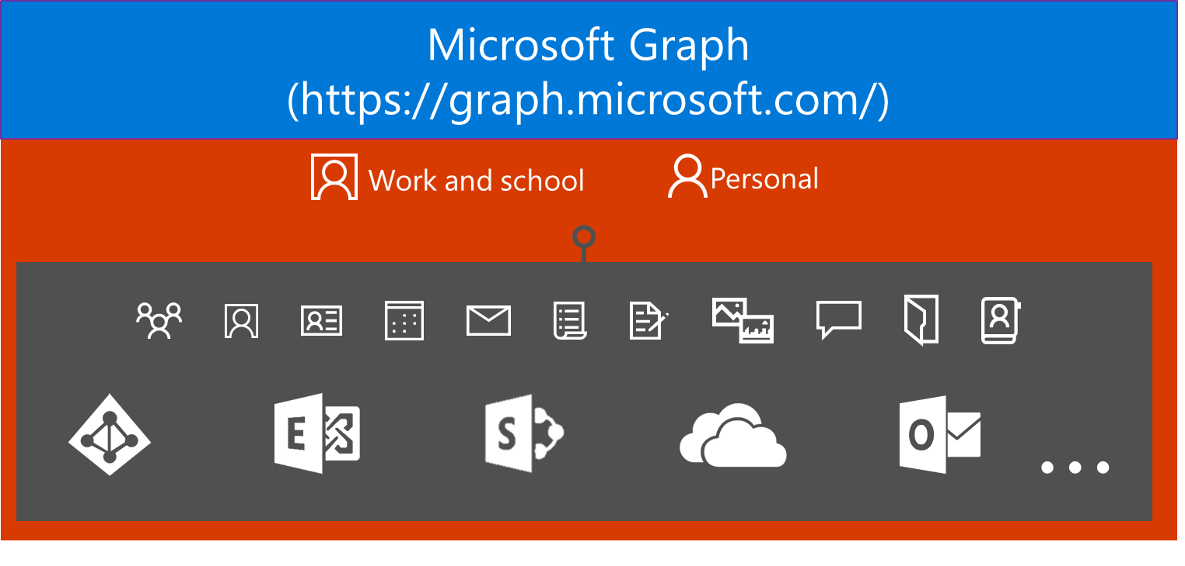
Today’s world with Microsoft Graph

Slide 9
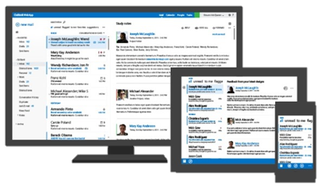
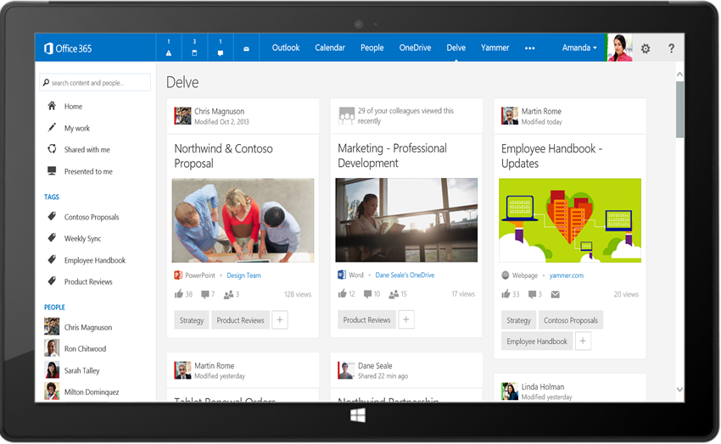
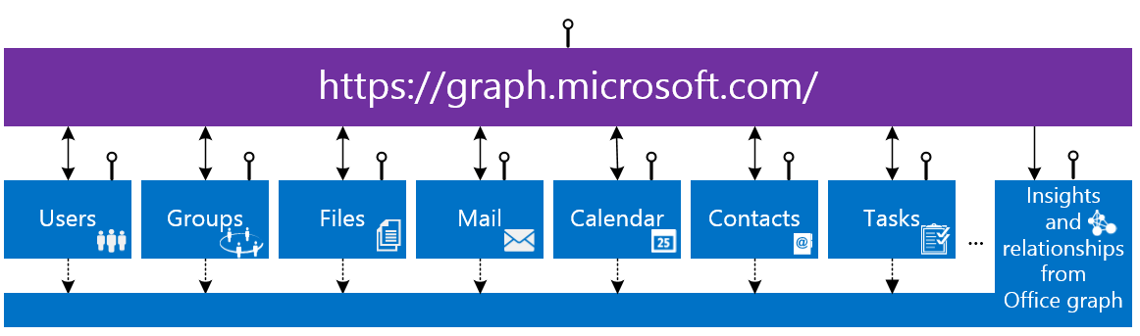
Microsoft Graph API
Your App
https://graph.microsoft.com/

Slide 10









Microsoft Graph SDKs
Android
ASP.NET MVC
Python
SDK Code
SDK Code
SDK Code
AngularJS
Ruby
PHP
SDK Code
SDK Code
SDK Code
JavaScript
UWP
iOS
SDK Code
SDK Code
SDK Code

Slide 11
Unified API Style & Single Endpoint
https://graph.microsoft.com
Operation | Service Endpoint
GET my profile | https://graph.microsoft.com/v1.0/me
GET my files | https://graph.microsoft.com/v1.0/drive/root/children
GET my photo | https://graph.microsoft.com/v1.0/photo/$value
GET my mail | https://graph.microsoft.com/v1.0/me.messages
GET my calendar | https://graph.microsoft.com/v1.0/me/calendar
GET my manager | https://graph.microsoft.com/v1.0/me/manager
GET group conversations | https://graph.microsoft.com/v1.0/groups/<id>/conversations
GET files trending around me | https://graph.microsoft.com/v1.0/me/insights/trending

Slide 12
What’s been GA over the last year?
Azure Active Directory
Outlook mail, Calendar and Contacts
Office 365 Groups and Conversations
OneDrive Drives and Files
WebHooks for Outlook data
SharePoint & LiveID profiles
Notes:
SharePoint and LiveID Profiles???

Slide 13
What’s new in GA?
Excel API
WebHooks for OneDrive
Extend Graph with your own LOB info for Outlook
FindMeetingTimes scheduling API

Slide 14
What’s new in Preview?
SharePoint Sites and Lists
Hybrid On-premises support for Outlook
@Mentions social gestures
Simpler query syntax without $
OneDrive large file upload
Azure AD
Administrative Units
Invitation Manager
Privileged Identity Management
Identity Protection
Application Proxy
Coming Soon
Delta queries for Outlook and Azure AD
Intune API
Office 365 Reports

Slide 15
What we don’t have (yet)
Support for SharePoint Framework (SPFx)
The richness the current specific Office 365 APIs offer

Slide 16

Graph, Graph, Graph
Azure AD Graph
Open Graph
Office Graph
GQL
Office 365 Unified API
Microsoft Graph
….
Notes:
Azure AD Graph = Active directory API
Open Graph = Yammmer query api
Office Graph = the analytics system behind delve and many of the relations and can be queried either by SharePoint or Microsoft Graph
GQL is the Graph Query Language behind the Office Graph
Microsoft Graph is the Office 365 Unified API

Slide 17
DEMO
Graph Explorer with work and personal accounts

Slide 18
Microsoft Graph
Authentication and libaries

Slide 19
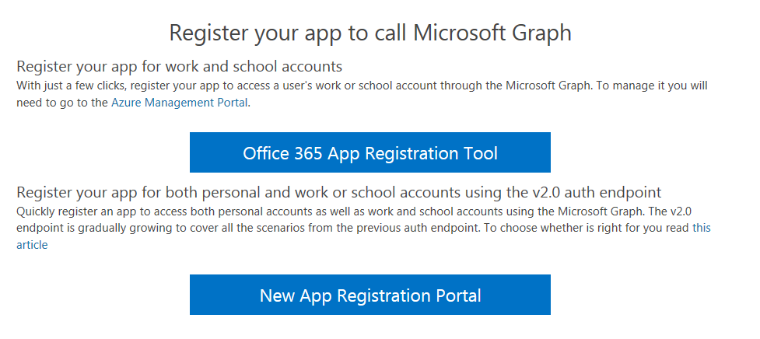
App registration options

Slide 20
Authentication
ADAL v1.0
MSAL v2.0 (preview)
Authentication library to deal with Azure Active Directory authentication flow
Support for Work and School accounts via Azure Active Directory
Full set of SDKs available
Supports Office 365 Services
User gives consent for all permissions at first start
Unified authentication libary to deal with authentication across the different identity platforms provided by Microsoft
Support for Work, School and Personal accounts – No Azure requirement
User gives consent when the applications needs it
Notes:
https://azure.microsoft.com/en-us/documentation/articles/active-directory-v2-compare/
Restrictions: https://azure.microsoft.com/en-us/documentation/articles/active-directory-v2-limitations/

Slide 21
MSAL v2.0 limitations
Complete list of limitations at docs.microsoft.com
Still in Preview!
Limited SDKs (MSAL.NET covers the Microsoft stack)
Limited API endpoints: https://outlook.office.com and https://graph.Microsoft.io
OpenID Connect UserInfo endpoint is not available on the v2.0 endpoint. You need to call Microsoft Graph /me endpoint for this
Web API on-behalf-of flow is not supported
Device based conditional access

Slide 22
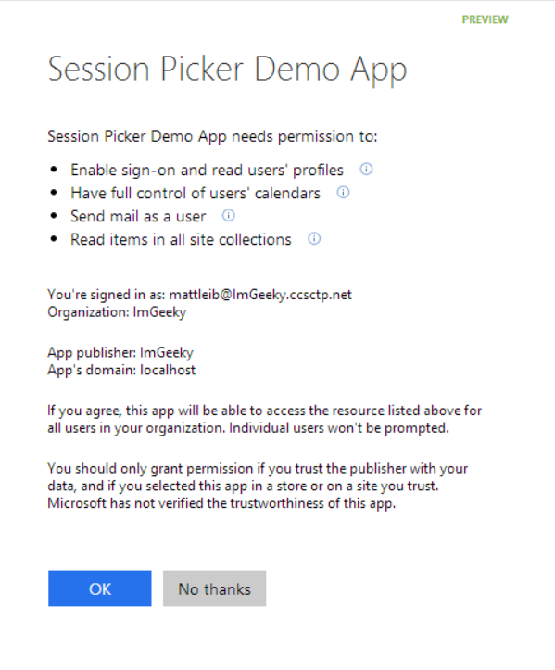
ADAL - Azure Active Directory and Office 365
Single auth flow for O365
Sign users in using OpenID Connect
Azure AD, Exchange, SharePoint, Yammer, OneNote
Device apps, web sites, SPAs, and service apps
Admin and end-user consent
Secure protocol
OpenID Connect and OAuth 2.0
No capturing user credentials
Fine-grained access scopes
Supports MFA and federated user sign-in
Long-term access through refresh tokens

Slide 23
Consent
User Consent
Consent provided by the user
Any user in the organisation can install the application
Implemented by default, but can be switched off by the Office 365 Admin
Admin Consent
Consent provided by an Office 365 Global Administrator
Only Office 365 global administrators
Consent is given to all users in the organisation
Only required for multi-tenant applications or native applications

Slide 24
Register your Application
Sign in to the Azure Management Portal
Create a new application
Select the Scope (Single / Multi-Tenant)
Get Client ID
Generate Client Secret (Web apps only)
Add Redirect URLs
Select Permissions

Slide 25
Revoke User Consent
Native Application
Consent is part of the Refresh Token and typically stored on the device
Revoke Consent typically means uninstall the application or clear TokenCache
Web Server Applications
Consent is stored in Azure Active Directory and not part of the Refresh Token
User can Revoke Consent at http://myapps.microsoft.com

Slide 26
DEMO
APP Registration in Azure AD
Authentication

Slide 27
Autentication to Office 365
Azure AD Authorization
Endpoint
Azure AD Token
Endpoint
Your Application
Microsoft Graph API
Request authorization code
Sign-in via browser pop-up
Return authorization code
Redeem authorization code and acquire access token for Office 365 resource
Return id, access, and refresh tokens
Call Microosft Graph API using the access token
Return Http Response
Notes:
Authorization flow

Slide 28
Microsoft Graph Groups
DEMO with ASP.NET MVC 5

Slide 29
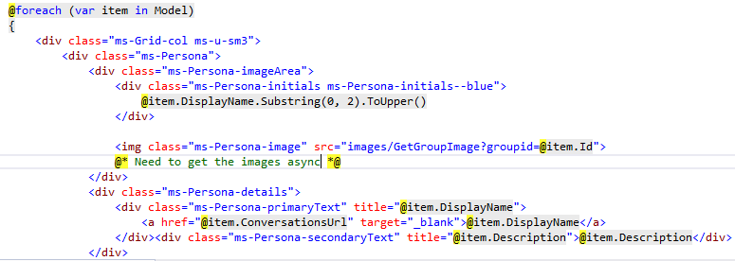
Showing the images

Slide 30
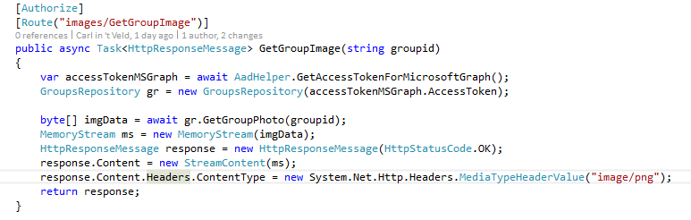
Receiving the images

Slide 31
Webhooks
Get Notifications from changes in User Data
Notes:
https://github.com/microsoftgraph/aspnet-webhooks-rest-sample

Slide 32
Webhooks
Microsoft Graph REST API clients can subscribe to changes:
Messages
Events
Contacts
Group conversations
Drive root items

Slide 33
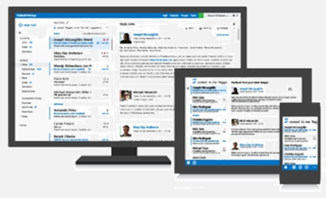
Webhooks
Your App
1. CREATE
/notifications
2. VALIDATE
3. NOTIFY
/subscriptions
Outlook Apps
graph.microsoft.com
outlook.com

Slide 34
Subscription API
APIs
Create, Read, Delete a subscription
Update a subscription to extend the expiry date
Endpoint Validation
Synchronous part of subscription creation
Respond by echoing back the parameter
Use clientState to check validity
{
changeType: "created updated deleted",
notificationUrl: "URL",
resource: "string",
expirationDateTime:
"ISO Date",
clientState: "string",
id: "string"
}

Slide 35
Subscription API Example
POST https://graph.microsoft.com/v1.0/subscriptions
Content-Type: application/json
{
"changeType": "created,updated",
"notificationUrl": "https://webhook.azurewebsites.net/notificationClient",
"resource": "/me/mailfolders('inbox')/messages",
"expirationDateTime": "2016-03-20T11:00:00.0000000Z",
"clientState": "SecretClientState"
}

Slide 36
Notification API Example
{
"value":[
{
"id":"<subscription_guid>",
"expirationDateTime":"\"2016-03-19T22:11:09.952Z\"",
"clientState":"SecretClientState",
"changeType":"Created",
"resource":"Users/<user_guid>@<tenant_guid>/Messages/<long_id_string>",
"resourceData":
{
"@odata.type":"#Microsoft.Graph.Message",
"@odata.id":"Users/<user_guid>@<tenant_guid>/Messages/<long_id_string>",
"@odata.etag":"W/\"CQAAABYAAADkrWGo7bouTKlsgTZMr9KwAAAUWRHf\"",
"Id":"<long_id_string>"
}
}
]
}

Slide 37
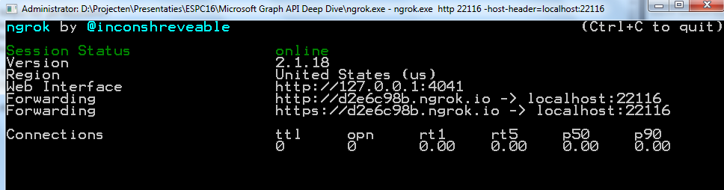
NGROK
Webhook requires a public endpoint for sending its notifications
When developing, your notification endpoint is running on https://localhost
Use NGROK to tunnel the requests from a public endpoint to http://localhost
ngrok.exe http 22116 -host-header=localhost:22116

Slide 38
DEMO
Webhooks

Slide 39
Microsoft Graph in the SharePoint System

Slide 40



Microsoft Graph in the SharePoint System
SharePoint Apps
C#
Microsoft Graph API
SharePoint
REST
CSOM
SharePoint API
List and Libraries
OneDrive
For Business
Pages
Team Sites
News

Slide 41
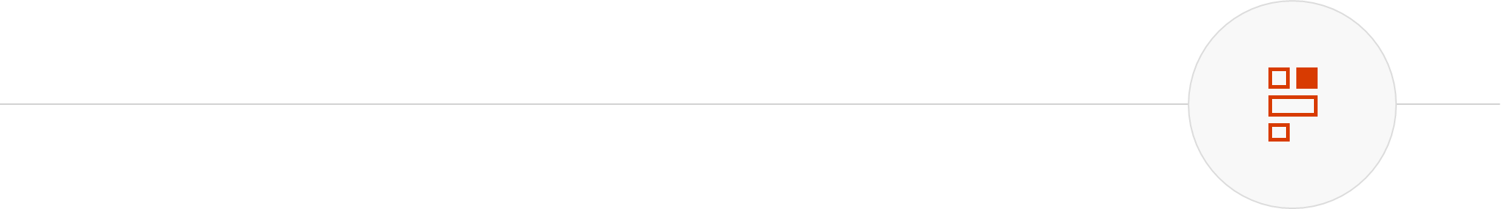
API Spectrum
CSOM + REST
Shares same core pipeline
Deep extensibility across SharePoint, Project, and beyond
CSOM: JS and .NET client libraries; more advanced
REST: Web-based projection with REST semantics
Microsoft Graph
Unified API endpoint for accessing Microsoft data
Follows new Microsoft REST API guidelines
Consistent look and feel between services
Seamless navigation between entities

Slide 42
App Only Operations

Slide 43
Azure AD App Only with Microsoft Graph
Before background operations where done via an ACS ClientID / Client Secret
Azure AD App Only provides:
A more secure way of doing background operations by using a certificate trust relationship
Consumption of other services than just Microsoft Graph
Allows you to do multi tenant

Slide 44
App Only - Certificate
Requires a certificate for authentication
Azure AD will get the public key
App will get the private key
Use trusted certificates for production – issued by a well Certificate Authority
Can use self signed certificates for dev – test (MakeCert.exe)

Slide 45
Key takeaways
Microsoft Graph provides a single API endpoint including discoverability of Office 365 services
Not a replacement of existing APIs like SharePoint CSOM and Exchange Web Services
Great for composed device applications that spam a single service
Two ways to authenticate and register, ADAL (v1.0) and MSAL (v2.0 –preview)
For more advanced scenario’s specific service API’s like SharePoint CSOM is till required Microsoft Graph is protected by Azure AD compared to ACS for SharePoint CSOM
We will need to wait for SharePoint Framework (SPFx)

Slide 46
Thank You!

